Slide 1
Design Project (MATH F376) on The Finite Element Method/FDM in Electromagnetism Under the guidance of Dr. Sangita Yadav
Rasal Kumar 2014B4A80801P
C. Pranay Reddy 2014B4A80757P

Slide 2
Introduction
Numerical Analysis starts with the difficulties in finding the solution of an equation in a direct method or in a theoretical method proposed earlier to find the exact solution
We know the methods like Bisection method, Secant method, Newton Raphson method to find the root of an equation. But when the equation includes a differential operator i.e. a differential equation, the known numerical solution methods are Picards method, Runge kutta method etc.

Slide 3
Introduction
For a better solution i.e. for an approximated solution with lesser error we use various collocation methods. As there is no direct method to solve type of equations like Burger's equation and sine Gordon equation, hence for the solution, Finite element method can be used.
The project aims to study the application and use of finite element methods in electromagnetism. Electromagnetism is one of the evolving fields of science with various applications in real life

Slide 4
Aim and Progress
In the initial Phase, we considered two problems in electromagnetism. The first problem involves the problem of finding electric field on a parallel plate capacitor with a dielectric slab which involves one dimensional Poisson's equation.
The second problem involves the calculation of electric field on a Cylindrical surface involving the use of three dimensional Poisson Equation using polar coordinates.

Slide 5
Aim and Progress
The work done before midterm was based on the complete solution of one dimensional parallel plate capacitor problem and illustration of how to solve 2 dimensional Poisson equation using finite element method.
The project aimed at solving the two problems using finite element method and show the error between the finite element solutions and the exact solutions. At the later stage, We concentrated on solving using FDM Methods.

Slide 6
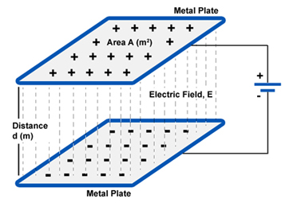
Parallel plate Capacitor
We are concerned about the electric potential

Slide 7
Parallel plate Capacitor

Slide 8
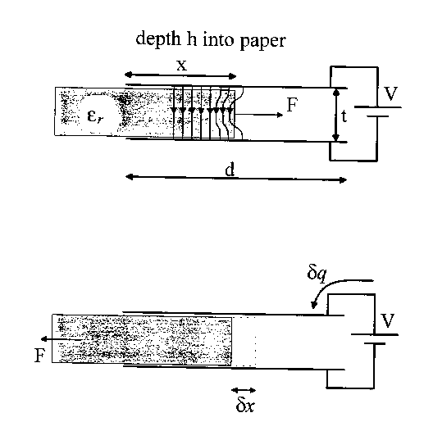
Dielectric Slab in a Capacitor

Slide 9
Dielectric Slab in a Capacitor
Steps to solve Boundary Value Problems:
• Solve the equation (Poisson / Laplace) in appropriate coordinate system.
• Apply boundary conditions.
• Calculate V.
• Use E=-Grad(V)
• D=eE and J= σE

Slide 10
Continued..
For the capacitor problem let us consider a dielectric placed in z direction with a uniform charge density ρ. Therefore

Slide 11
Continued..
z = 0 ,
z = d , V = 0

Slide 12
Continued..

Slide 13
Continued..

Slide 14
Results
The convergence criteria was 1e-08 (from the exact solution).
For N=11, the number of iterations needed for convergence were 1180.
For N=21, the number of iterations needed for convergence were 3742.
For N=41, the number of iterations needed for convergence were 12714.
All these results are without relaxation.

Slide 15
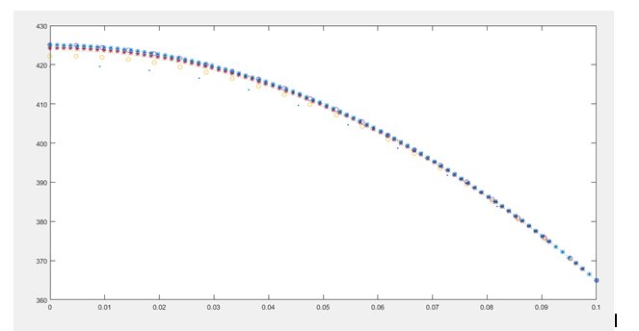
Plots

Slide 16
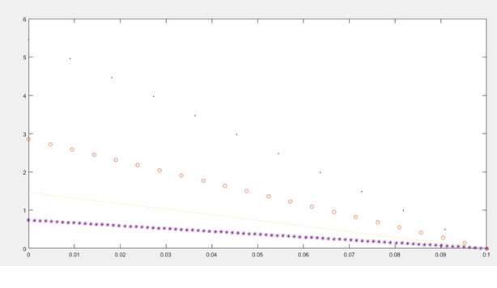
Plots

Slide 17
Results
Taking the boundary condition as first order played an important role in defining the voltage at other nodes as can be seen from the graph.
As the number of grid points are increased the error decreases, this is because as the size of grid decreases the governing equation can be approximated with linear relation for closer points. But, as the governing equation is of second order, in gauss siedel it is found that the potential values converges even for coarse grid size of N = 11. But the L2-norm of the second order approximation increases because as the number of grid points increases the error gets accumulated

Slide 18
Types of PDE's
A general second order PDE is of the form
Au_xx+Bu_xy+Cu_yy+Du_x+Eu_y+Fu=G
If B*B - 4 A*C < 0 -- Elliptic
= 0 -- Parabolic
> 0 -- Hyperbolic

Slide 19
Parabolic PDE
u_t=u_xx;
u(x,0)=sin(πx);
u(0,t)= 0;u(1,t)= 0

Slide 20
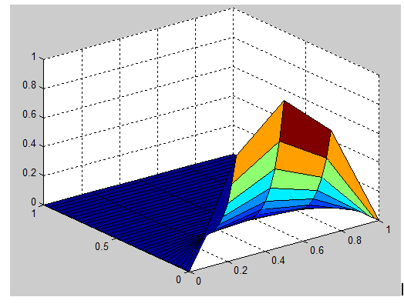
PLOT

Slide 21
Elliptic PDE
u_xx+u_yy= -2 π^2 u
u = 0 on boundary.

Slide 22
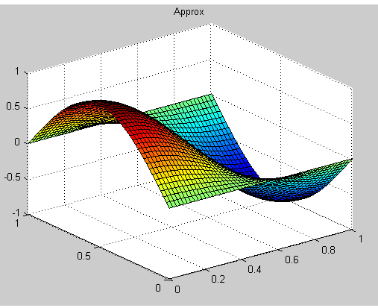
PLOT

Slide 23
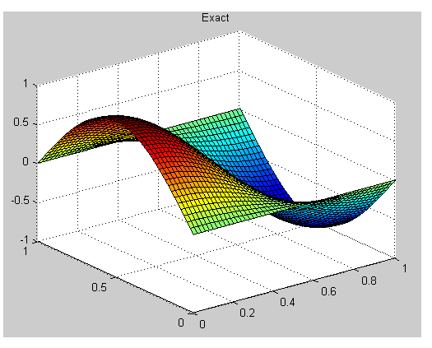
PLOT

Slide 24
Laplace Equation
u_xx+u_yy= 0

Slide 25
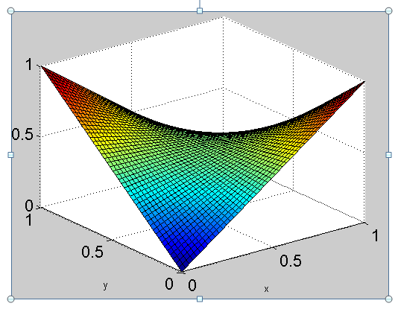
PLOT

Slide 26
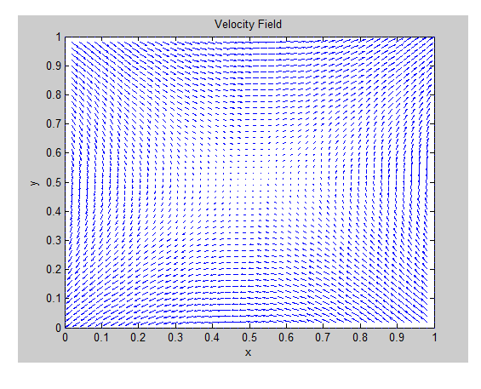
PLOT

Slide 27
Hyperbolic PDE
Advection equation
u_t= -vu_x

Slide 28
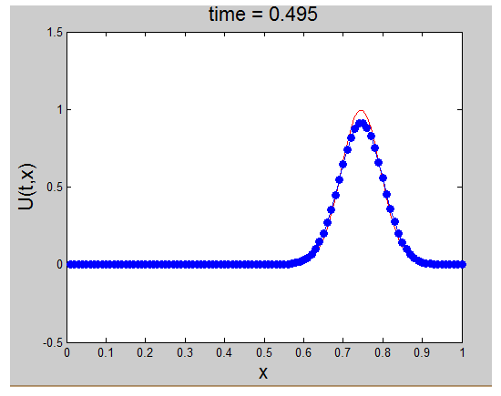
PLOT

Slide 29
Non Linear Pde
u_t+6uu_x+u_xxx=0;
u(x,0)=A.sech^2 (Kx);
u(-20,t)= u(20,t)
-20 < x < 20; t > 0.

Slide 30
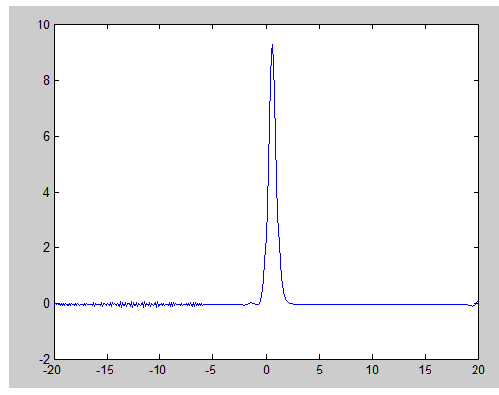
Plot BTCS

Slide 31
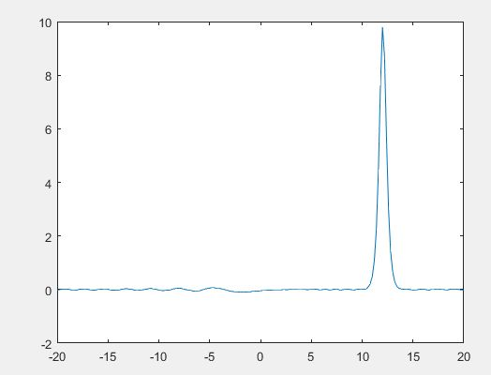
Non Linear Crank Nicholson

Slide 32
References
1. R. Courant, "Variational methods for the solution of Problems of Equilibrium and vibrations", Bull. Am. Math. Soc., vol. 49, 1943.
2. J. F. Hoburg, J. L. Davis, "A student-oriented finite element program for electromagnetism problems", IEEE Trans. Educ., vol. E-26, pp. 138-142, Nov. 1983.
3. The Finite Element Method in Electromagnetics, 3rd Edition
Jian-Ming Jin, Mar 2014.
4. Wikipedia
5. Www.mathworks.com

Slide 33
THANK YOU

